Slide 1
VSMUG – 2021-12
User Group Lead
Justin Chalfant
justin@patchmypc.com
Patch My PC
Twitter: @SetupConfigMgr
Virtual System Management User Group
Website: https://vsmug.com/
Content: https://vsmug.com/github
Twitter: @V_SMUG
YouTube: https://vsmug.com/youtube

Slide 2
Top 10(?) Tips for Optimizing WSUS Performance and Reliability
Justin Chalfant
Cody Mathis

Slide 3
SQL Memory
WID defaults to ‘unlimited’ SQL memory
Maybe not a big deal if this is a dedicated WSUS box
Shared SQL instance?
If SUSDB and CM_<SiteCode> are on the same instance they are sharing a memory pool
Low memory allocation can cause timeouts when querying WSUS
Notes:
How to adjust- https://docs.microsoft.com/en-us/sql/database-engine/configure-windows/server-memory-server-configuration-options?view=sql-server-ver15

Slide 4
Create custom indexes (manually)
-- Create custom index in tbLocalizedPropertyForRevision USE [SUSDB] CREATE NONCLUSTERED INDEX [nclLocalizedPropertyID] ON [dbo].[tbLocalizedPropertyForRevision] ( [LocalizedPropertyID] ASC )WITH (PAD_INDEX = OFF, STATISTICS_NORECOMPUTE = OFF, SORT_IN_TEMPDB = OFF, DROP_EXISTING = OFF, ONLINE = OFF, ALLOW_ROW_LOCKS = ON, ALLOW_PAGE_LOCKS = ON) ON [PRIMARY] -- Create custom index in tbRevisionSupersedesUpdate CREATE NONCLUSTERED INDEX [nclSupercededUpdateID] ON [dbo].[tbRevisionSupersedesUpdate] ( [SupersededUpdateID] ASC )WITH (PAD_INDEX = OFF, STATISTICS_NORECOMPUTE = OFF, SORT_IN_TEMPDB = OFF, DROP_EXISTING = OFF, ONLINE = OFF, ALLOW_ROW_LOCKS = ON, ALLOW_PAGE_LOCKS = ON) ON [PRIMARY]
Notes:
How to adjust- https://docs.microsoft.com/en-us/sql/database-engine/configure-windows/server-memory-server-configuration-options?view=sql-server-ver15

Slide 5
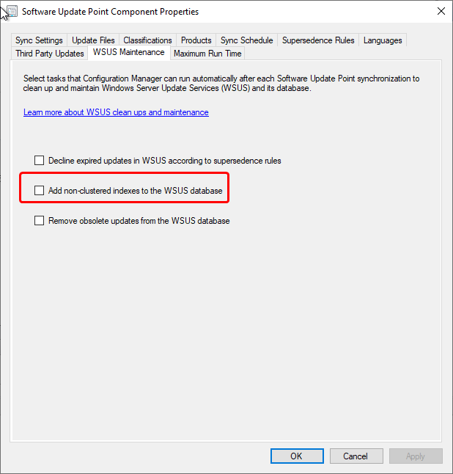
Create custom indexes (Configmgr)
ConfigMgr can create the indexes for you (probably)
Must have permission!
Notes:
How to adjust- https://docs.microsoft.com/en-us/sql/database-engine/configure-windows/server-memory-server-configuration-options?view=sql-server-ver15

Slide 6
Decline unneeded updates
Clients scan against all non-declined updates in WSUS
Superseded updates are generally not needed
ConfigMgr WSUS maintenance can remove these
Community solutions / MS solutions if standalone WSUS
Updates have a ‘size’ for their metadata
Decline unused ‘large’ updates
More updates = longer scans = more WSUS resource usage
Notes:
Decline unused ‘large’ updates - https://tcsmug.org/blogs/jeff-carreon/513-what-s-sup

Slide 7
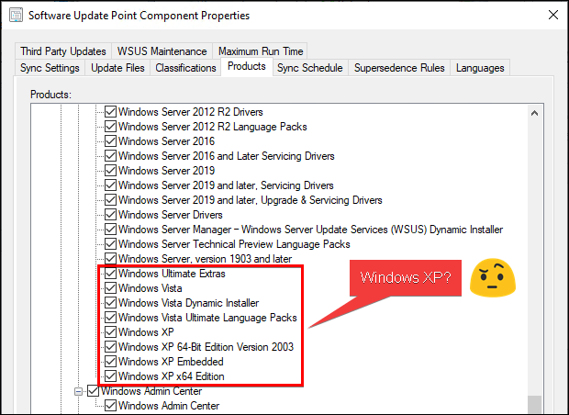
CHECK YOUR ENABLED CATEGORIES / PRODUCTS
Review the products enabled in the SUP
Notes:
Decline unused ‘large’ updates - https://tcsmug.org/blogs/jeff-carreon/513-what-s-sup

Slide 9
Section Header
This is the next section

Slide 10
Title
Line1
Bullet Level 1
Bullet Level 2
Bullet Level 3

Slide 11
Title
Code

Slide 12
Text Only with Border
Level 1
Level 2
Level 3

Slide 13
Text Only (Red)
Level 1
Level 2
Level 3

Slide 14
Title
Text 1
Level 1
Level 2
Level 3
Text 2
Level 1
Level 2
Level 3

Slide 15
Title
Section 1
Section 2
Text
Level 1
Level 2
Level 3
Text
Level 1
Level 2
Level 3

Slide 16
Demo Title

Slide 17





























Slide 18






























Slide 19




























Slide 20




























Slide 21




























Slide 22




























Slide 23




























Slide 24























Slide 25
















